Slide 1
Development of Cyber Physical Layer to defend EV Systems from Cyber Attacks: Simulation based Twining Approach
ESE 534 Cyber Physical Systems Project
Deepi Singh
Reetam Mandal
Yash Patel
Stony Brook University
Nov 2021

Slide 2
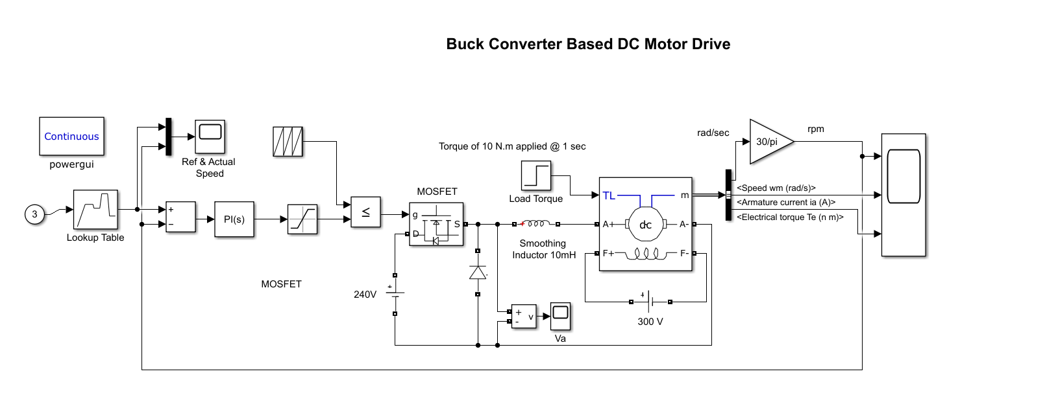
Simulink Block

Slide 3
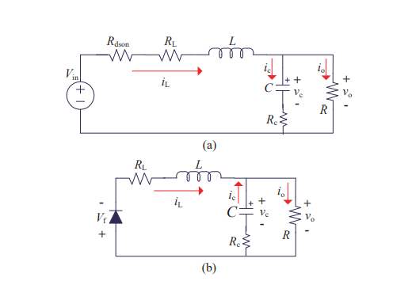
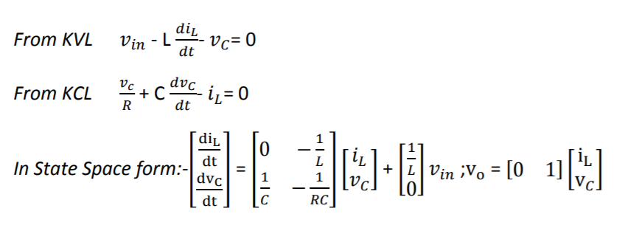
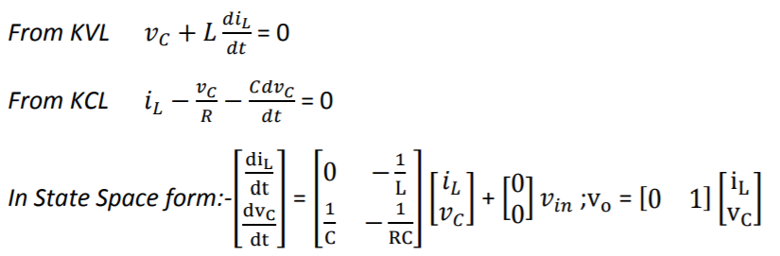
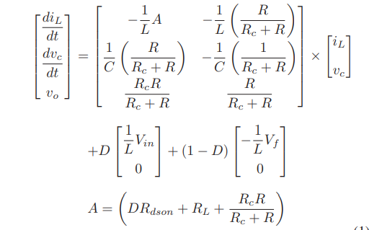
Mathematical Model of Buck Converter
In a Buck Converter, During ‘ON’ Mode:-
During ‘OFF’ Mode:-

Slide 5
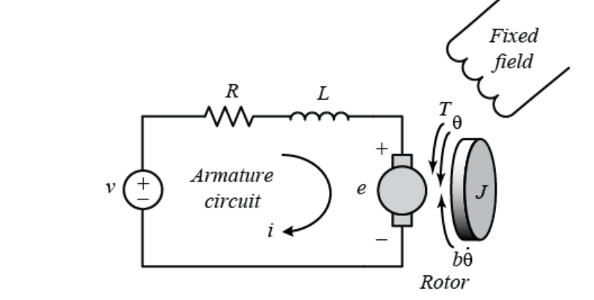
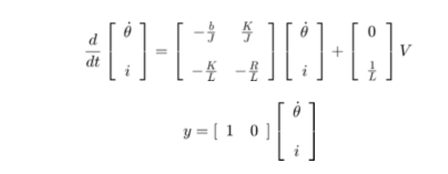
Mathematical Modelling of DC Shunt Motor

Slide 6
Future Goals
Mathematical Modelling of Controller
Solving State Equation models using Runge-Kutta 4th order Method.
Sampling Circuit modelling.
Develop Digital Twin based on modelling equations.

Slide 7
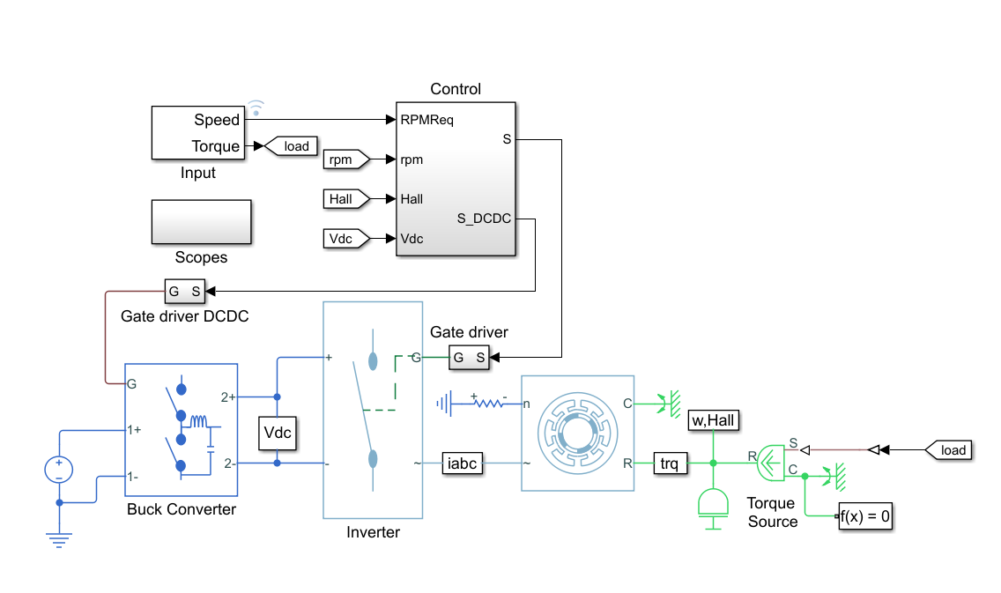
Sensor

Slide 8
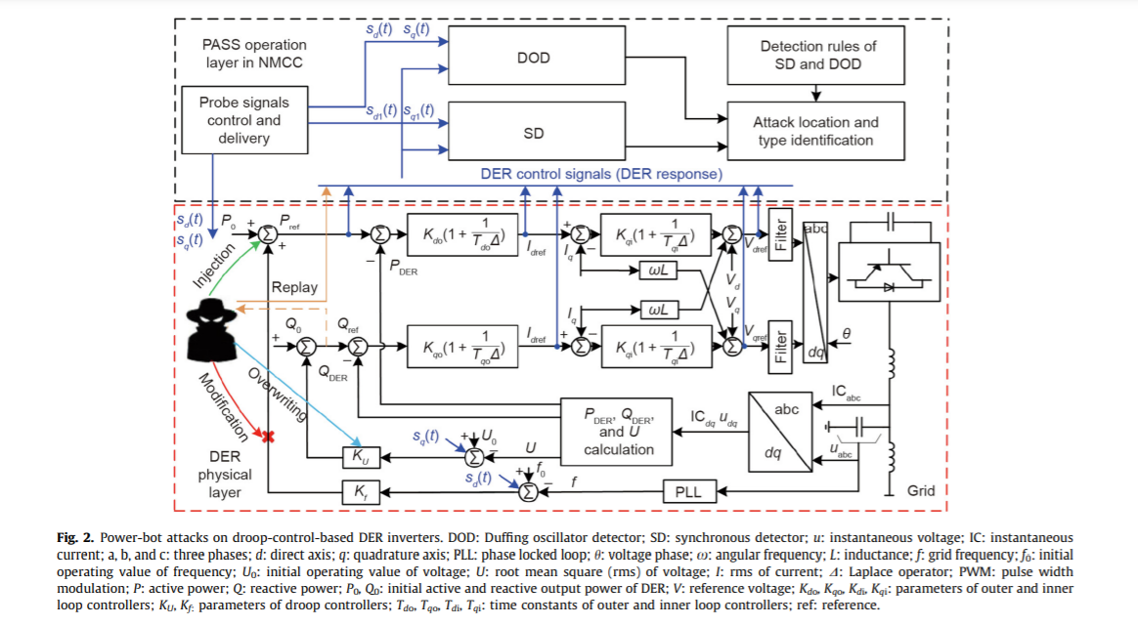
SDN-Enabled Cyber-Physical Security in Networked Microgrids IEEE TRANSACTIONS ON SUSTAINABLE ENERGY, VOL. 10, NO. 3, JULY 2019 Yan Li, Member, IEEE, Yanyuan Qin , Student Member, IEEE, Peng Zhang , Senior Member, IEEE, and Amir Herzberg

